Slide 1

Artificial Intelligence For NLP Lesson- 08 - 09
人工智能与自然语言处理课程组
2019.May. 26

Slide 2
Review
In Last lesson:
1. What’s the machine learning?
2. What’s the model ?
3. What’s the overfitting and under fitting, why?
4. What’s the classification and regression?
5. What’s the categorical and numerical?
6. What’s the outliner?

Slide 3
Outline
Supervised Learning
1. Classification and Regression
2. Logistic Regression
3. Bayes Models
4. KNN Models
5. SVM Models
6. Decision Tree
Scikit-Learning
Unsupervised Learning
K-means, hierarchy clustering, embedding clustering
Semi-Supervised Learning
Activate Leanring
Machine Learning + Search Policy
Importance of Preprocessing

Slide 4
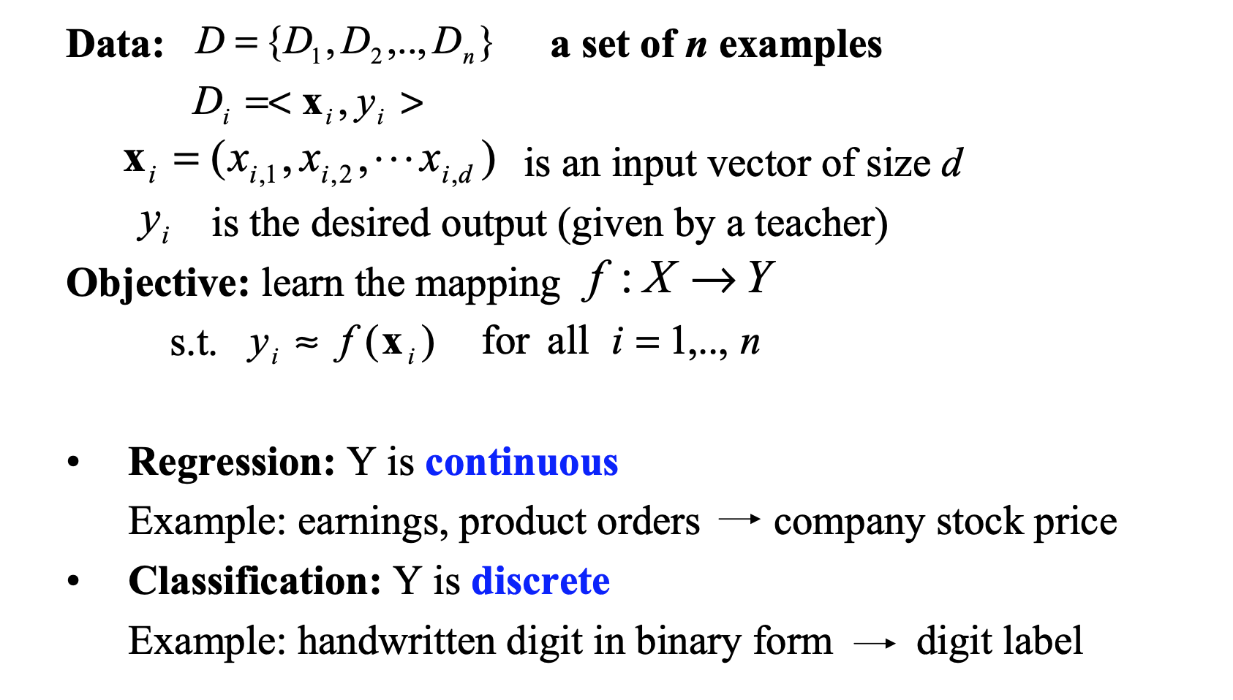
Supervised Learning

Slide 5
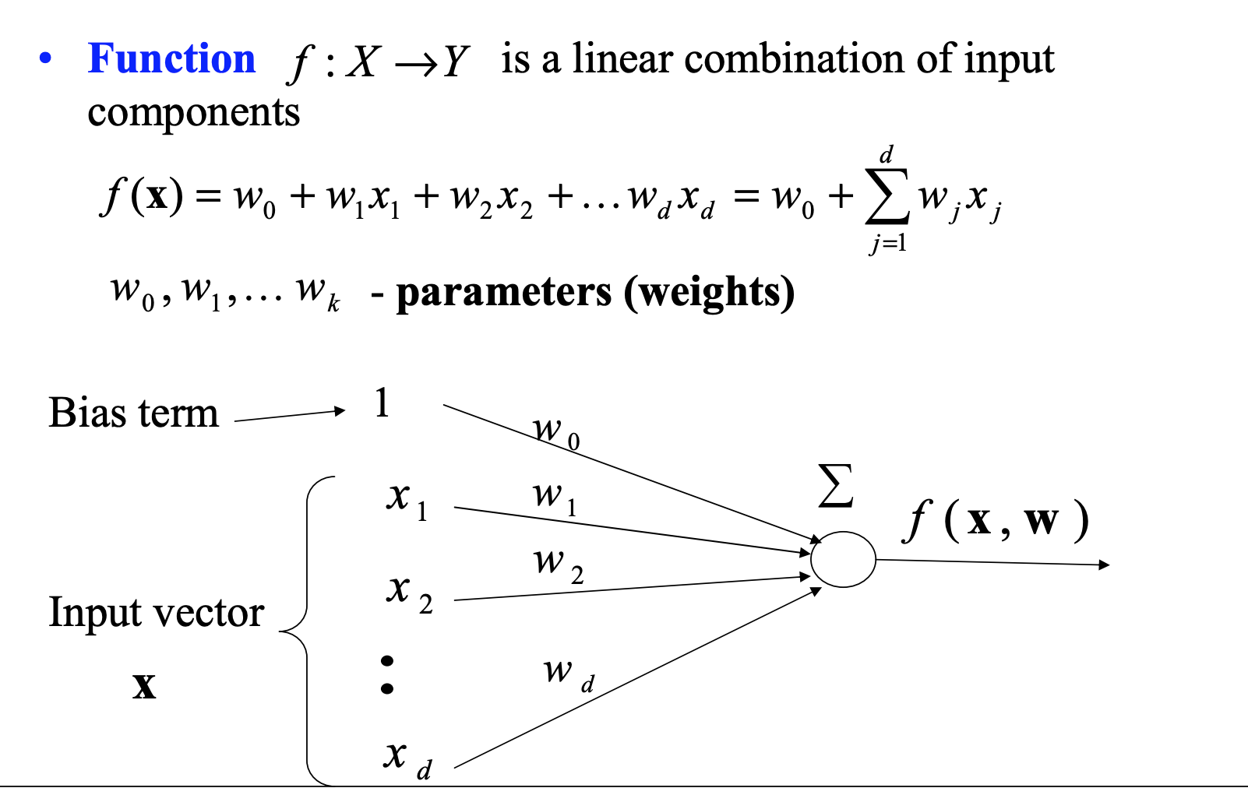
Linear Regression & Logistic Regression
Someone called ‘LR’ model.

Slide 6
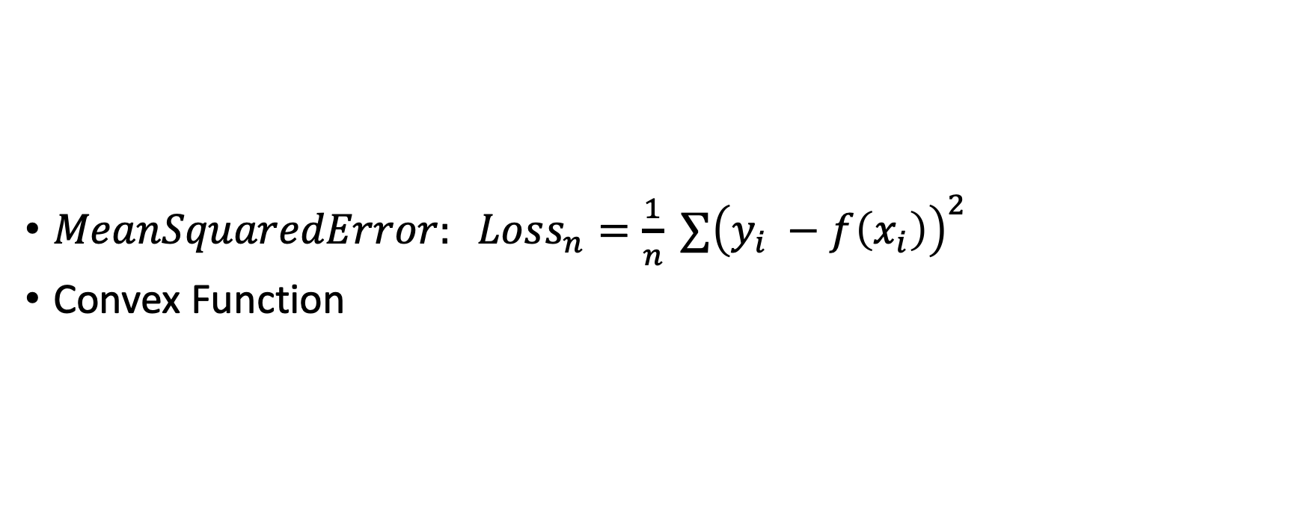
Mean Squared Error
$MeanSquaredError: Loss_{n}=\frac{1}{n} ∑{\left(y_{i} −f\left(x_{i}\right)\right)}^{2}$
Convex Function

Slide 7
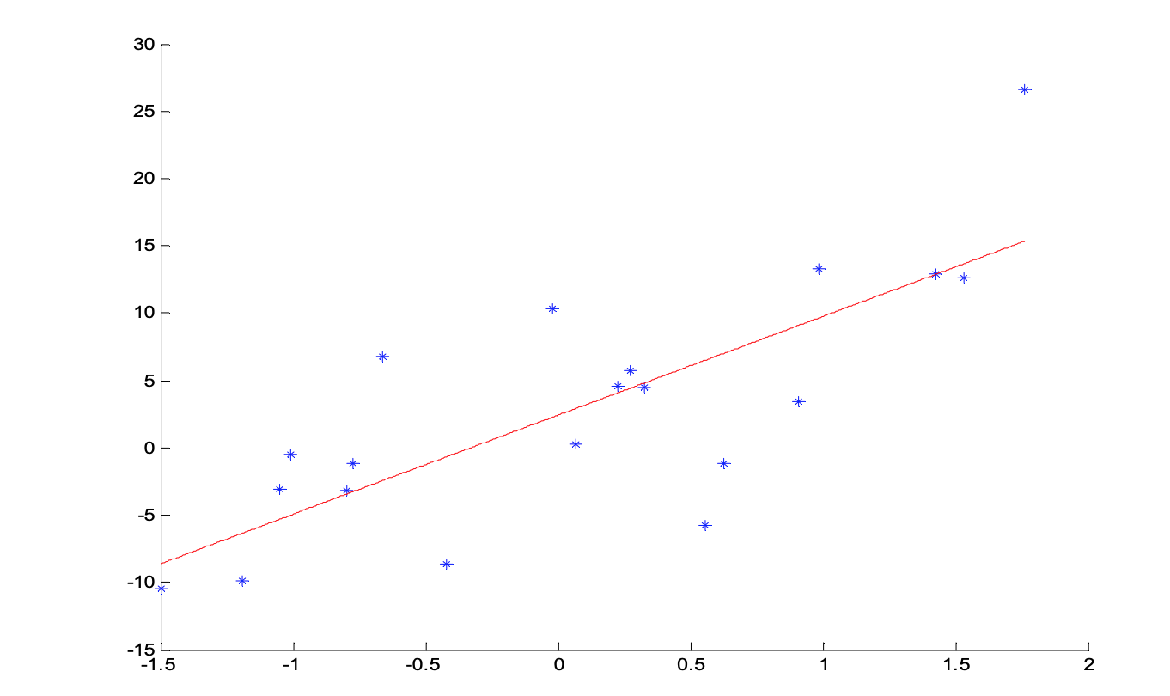
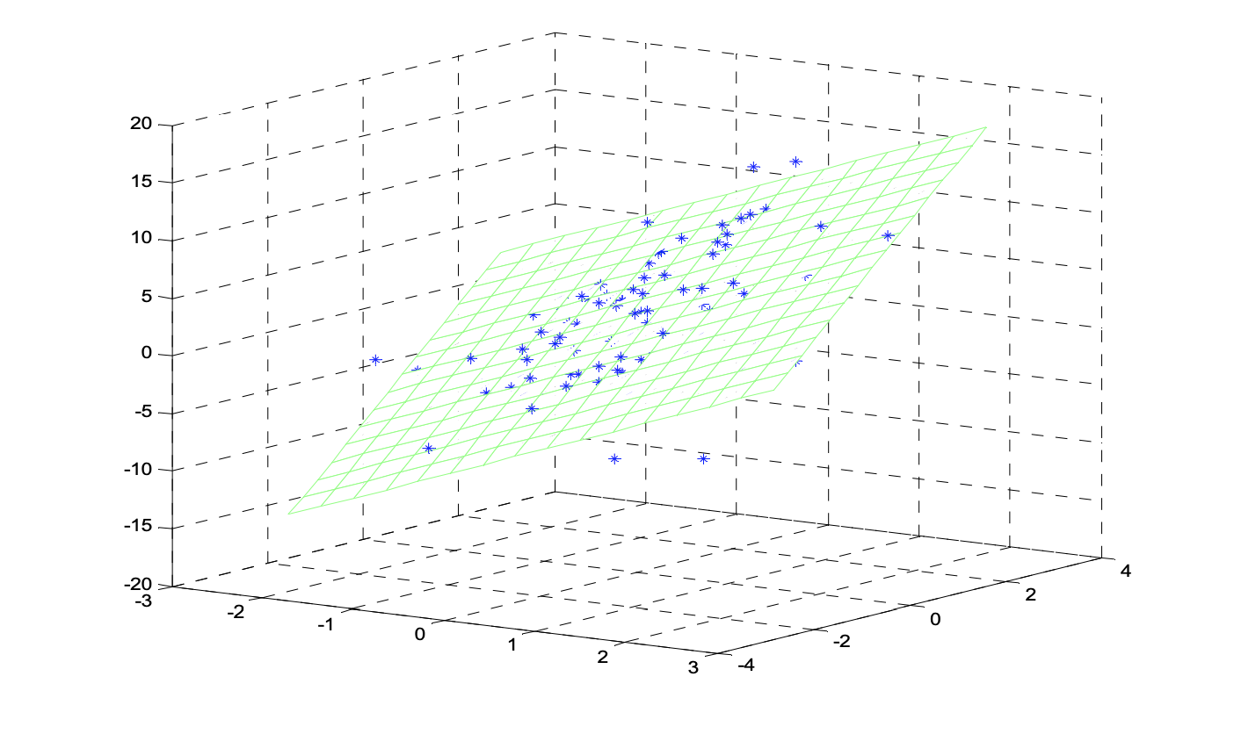

Slide 8
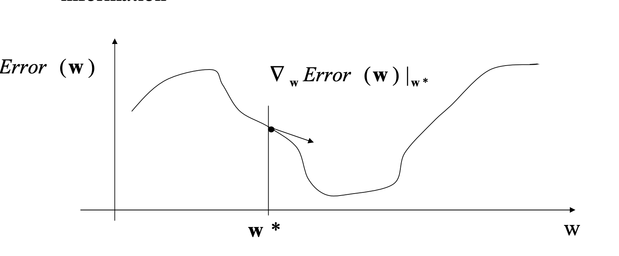
Gradient Descent

Slide 9
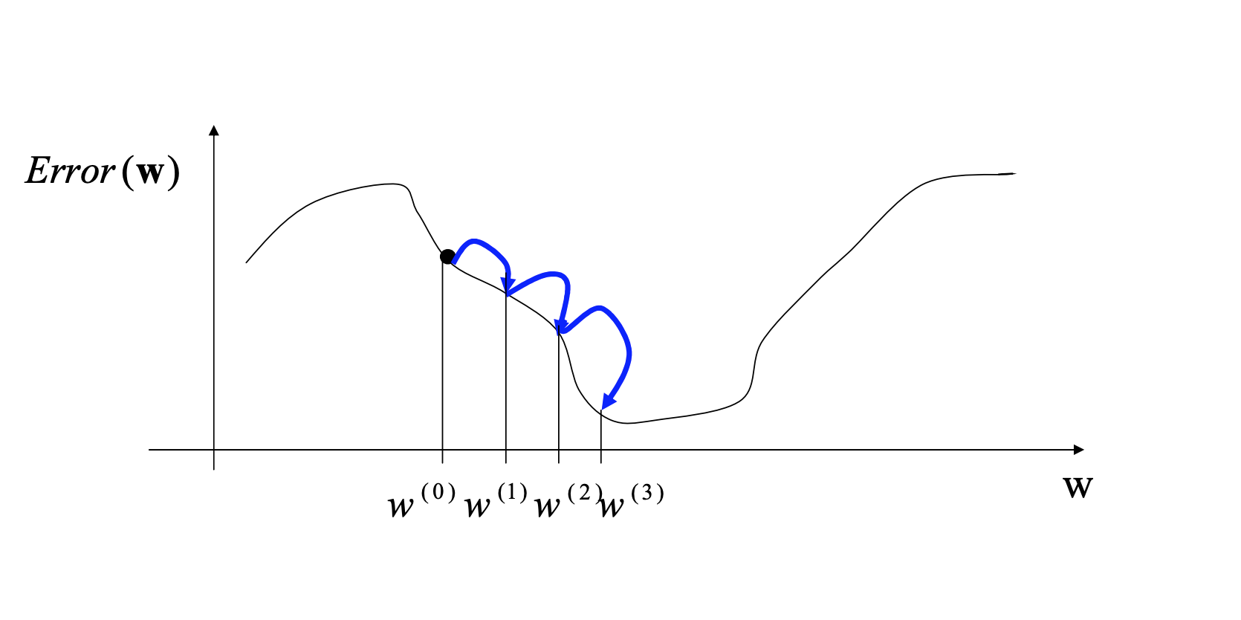

Slide 10
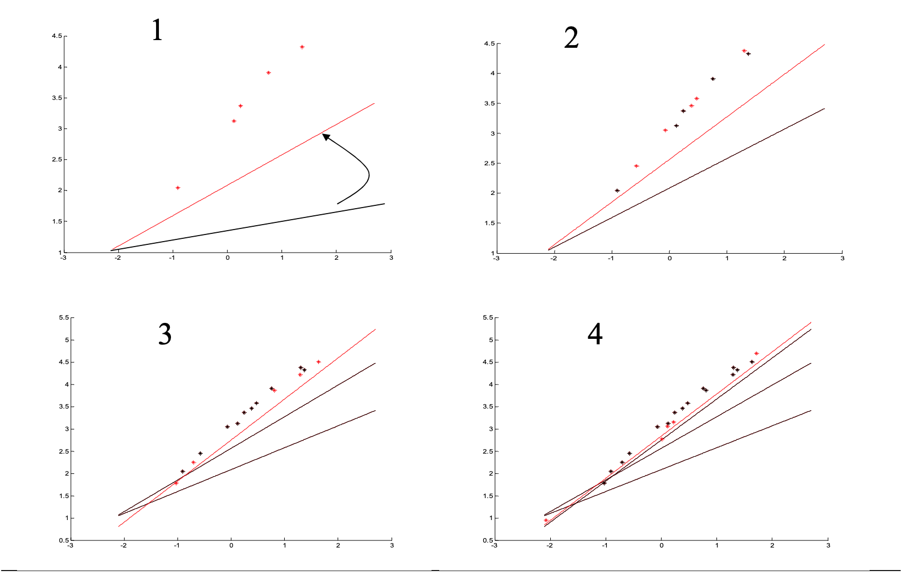

Slide 11
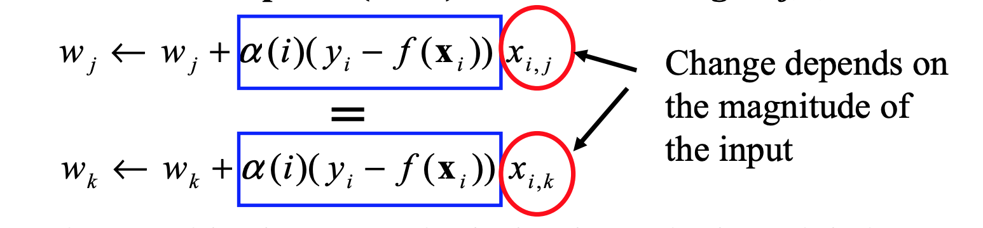
Practical Concerns
Normalization and Scalar

Slide 12
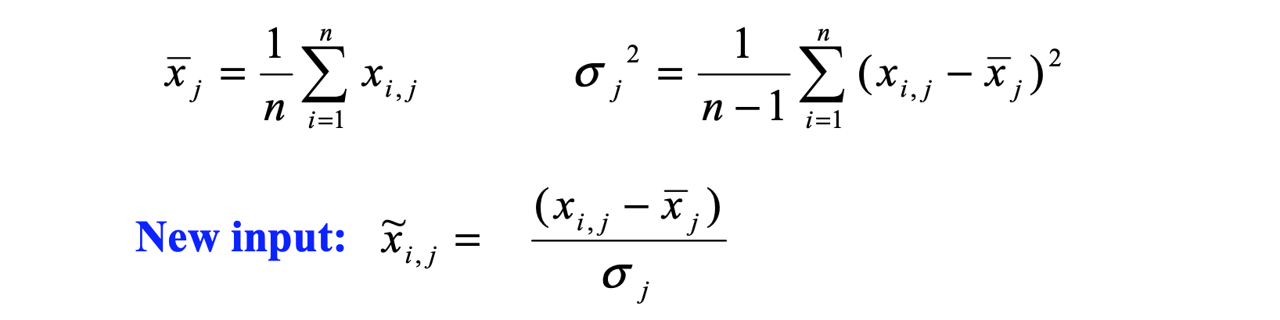

Slide 13
Feature function
Nonlinear attributes:
Bank Deposit
Timing
Etc

Slide 14
Scikit-learning
Scikit learning is our friend.
> We search it in Google.

Slide 15
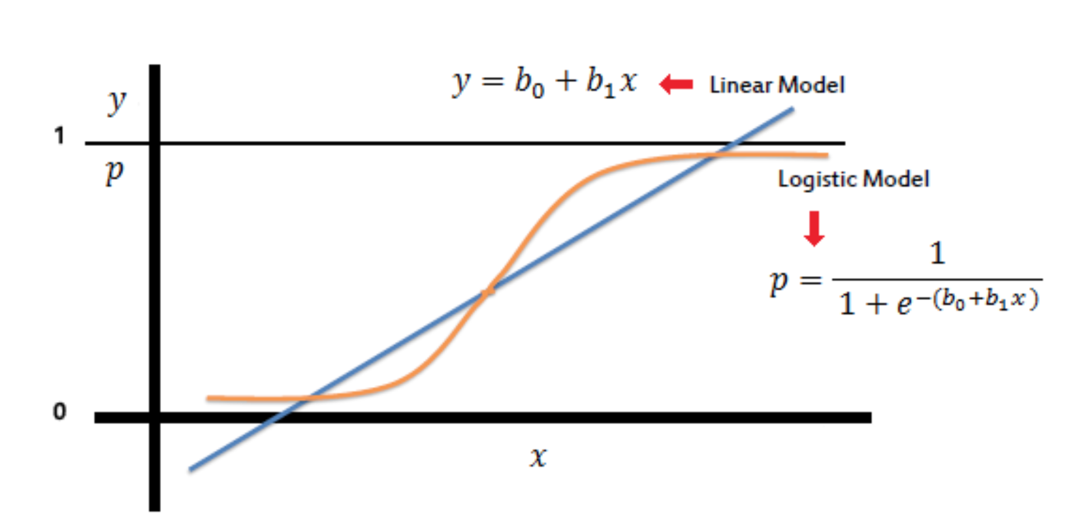
Logistic Regression

Slide 16
Loss Function and Gradient Descent
Practical Reference: https://github.com/SSaishruthi/LogisticRegression_Vectorized_Implementation/blob/master/Logistic_Regression.ipynb
Data Description: https://archive.ics.uci.edu/ml/datasets/iris

Slide 17
K-Nearest-Neighbors

Slide 18
KNN
If we want write a program solve it, it’s simple.
1-nearest neighbor classifier / regression
Weighted nearest neighbor classifier / regression
Maybe all the machine learning problem could use this method.
Dimension reduction
With the dimension increase, we need much more data to fit.
Euclidean distance is unhelpful in high dimensions because all vectors are almost equidistant to the search query vector. (Image a circle)
Outlinear
Memory Consuming
Timing Cusuming in high dimension

Slide 19
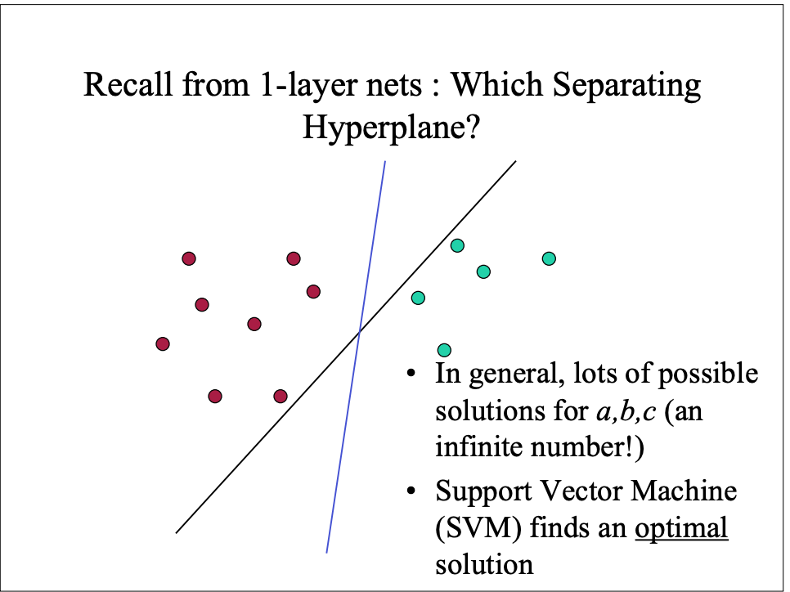
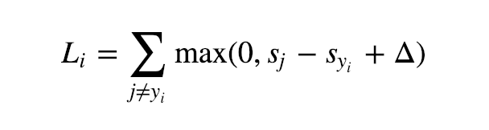
Support Vector Machine

Slide 20
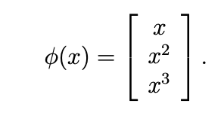
Kernel Function

Slide 21
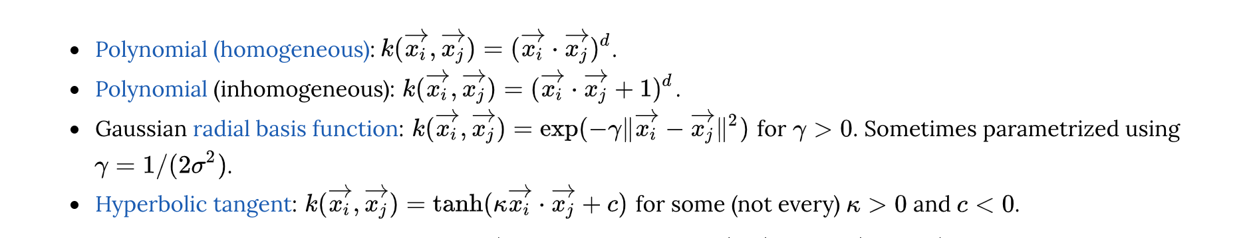
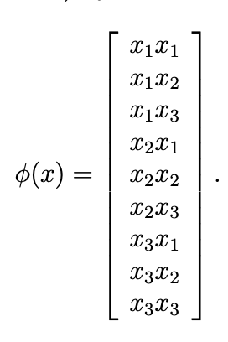
https://cs.stanford.edu/~karpathy/svmjs/demo/

Slide 22
Unbalance Problem

Slide 23
Important of Preprocessing
Balance Analysis: We need to know the balance information. Spam email.
Remove Noise. Our models assumes that your input and output variables are not noisy. Consider using data cleaning operations that let you better expose and clarify the signal in your data. This is most important for the output variable and you want to remove outliers in the output variable (y) if possible.
Remove Collinearity. Model over-fit your data when you have highly correlated input variables. Consider calculating pairwise correlations for your input data and removing the most correlated.
Rescale Inputs: Model will often make more reliable predictions if you rescale input variables using standardization or normalization.

Slide 24
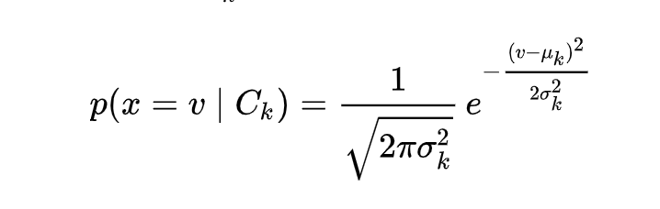
Bayes & Gaussian Bayesian Classifier
Gaussian Bayesian:
When dealing with continuous data, a typical assumption is that the continuous values associated with each class are distributed according to a Gaussian distribution. For example, suppose the training data contains a continuous attribute, x

Slide 25
Decision Tree

Slide 26
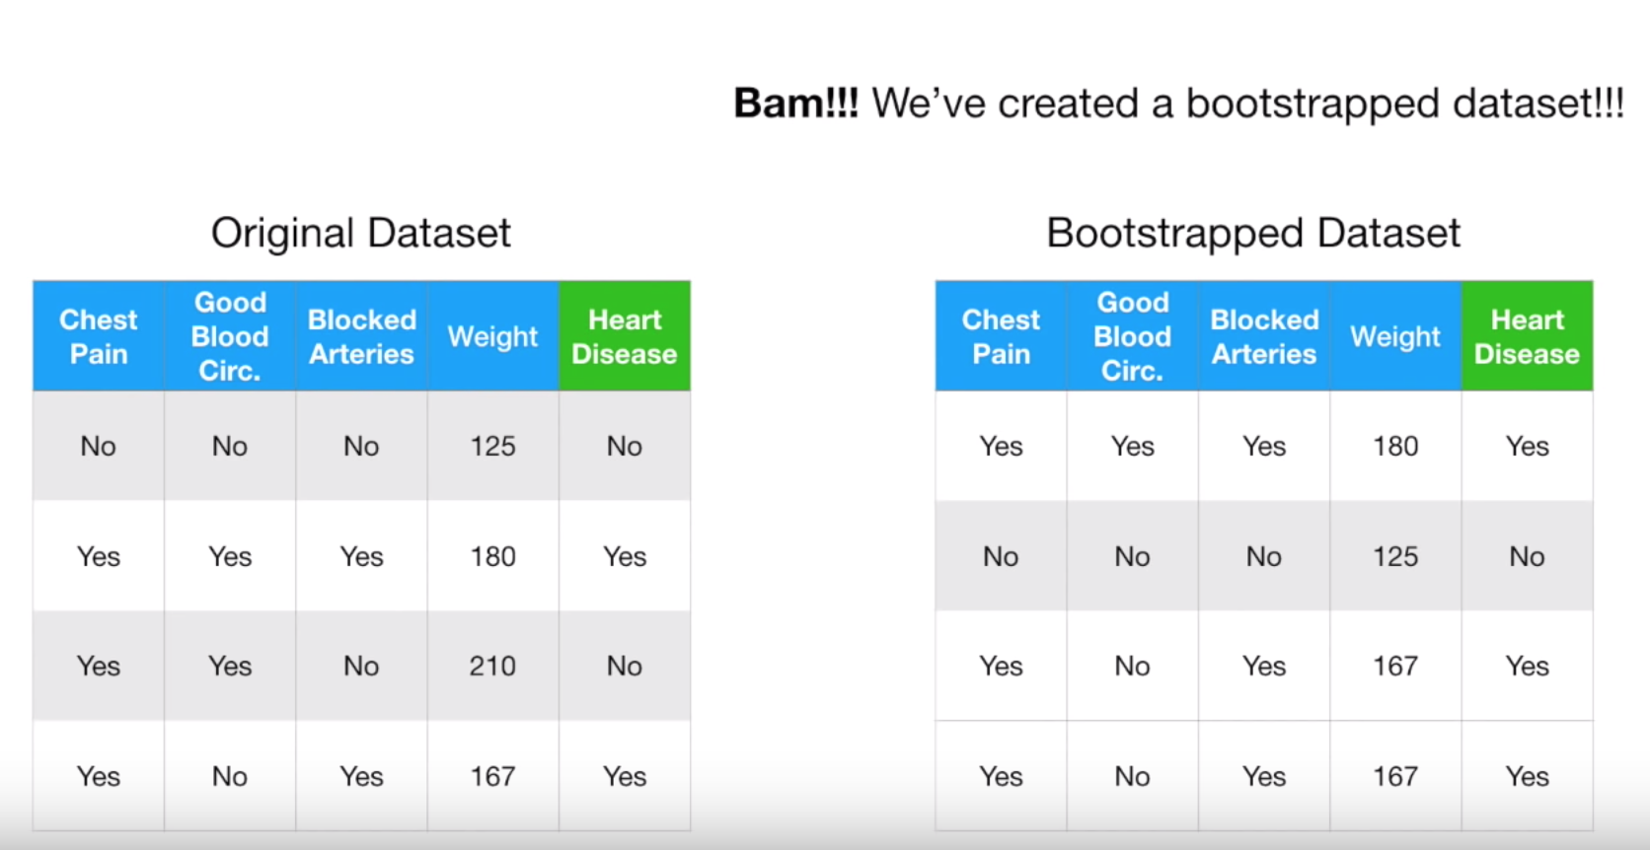
Random Forest
1. Create a ‘bootstraped’ data set

Slide 27
Random Forest
1. Create a ‘bootstraped’ data set

Slide 28
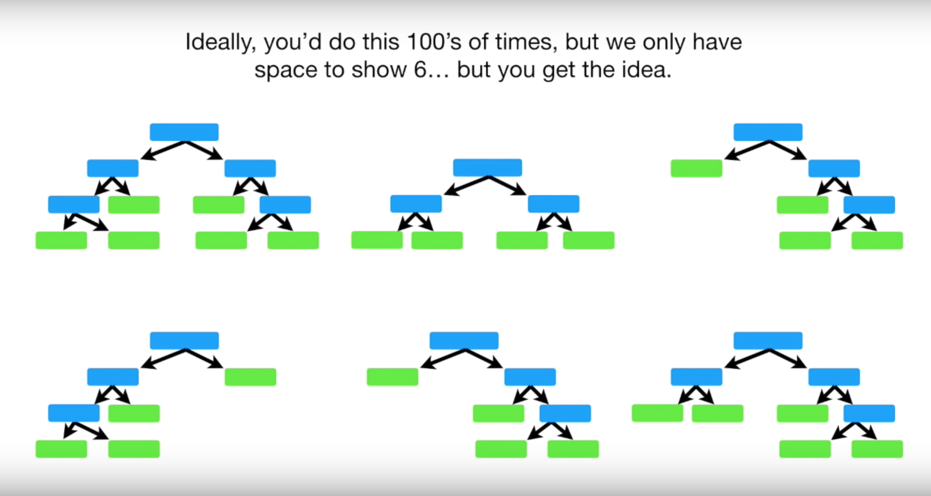
Random Forest
1. Predicate using the forest
2. Before predicating, we use Out-Of-Bagging sample to evaluate our model.
3. Using the evaluated result, we could choose the right variables number to be chosen in Random Forest.

Slide 29
XGBoost
https://arxiv.org/abs/1603.02754
An Excellent for Kaggle.

Slide 30
K-means Cluster

Slide 31
Embedding Cluster

Slide 32
Semi Supervised & Activate Learning

Slide 33
Assignments
1. Using the template to read the paper “XGBoost”
https://arxiv.org/abs/1603.02754
2. Using the new data to test different models
KNN, Logistic Regression, SVM, Bayes, Random Forest, XGBoost
To Classify if a new a by Xinhua.
3. Summary the advantages and disadvantages about Linear Regression, Logistic Regression, K-Nearest Neighbors, Support Vector Machine, Bayes, etc.

